Slide 1
CSE251: Electronic Devices and Circuits
Lecture: MOSFET
Credit:
Shadman Shahid (SHD)
Lecturer, Department of Computer Science and Engineering, School of Data and Sciences, BRAC University
Email: ext.shadman.shahid@bracu.ac.bd

Slide 2
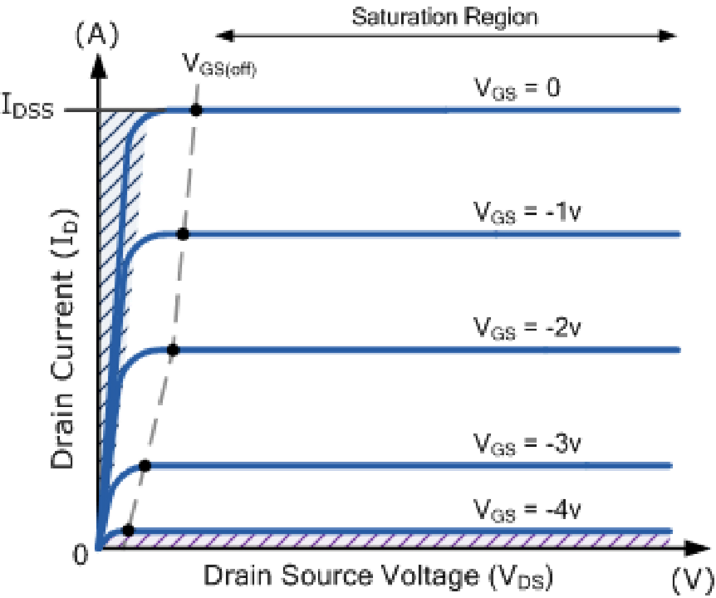
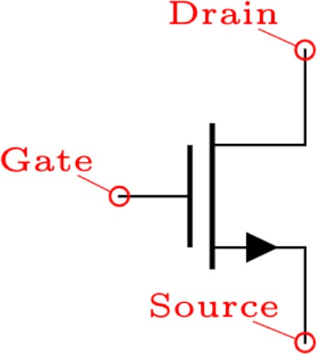
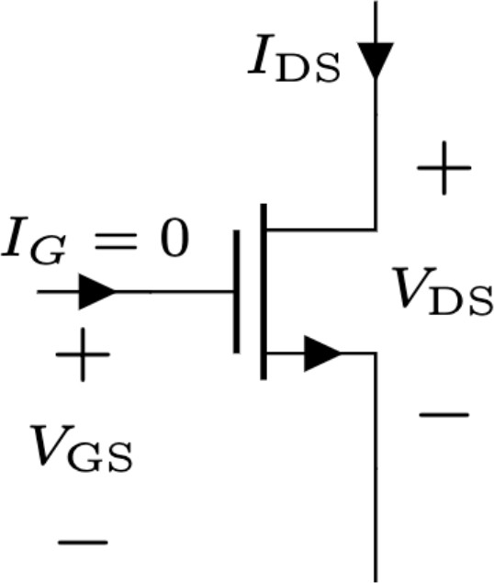
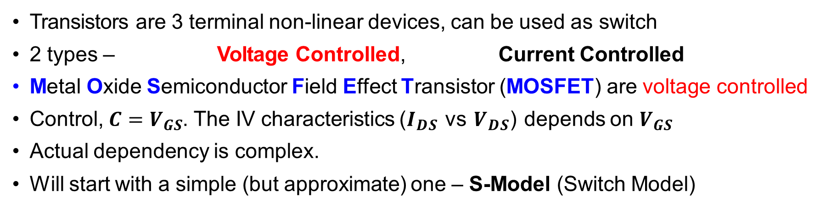
Transistors as Digital Switch
Transistors are 3 terminal non-linear devices, can be used as switch
2 types – Voltage Controlled, Current Controlled
Metal Oxide Semiconductor Field Effect Transistor (MOSFET) are voltage controlled
Control, $C=V_{GS}$. The IV characteristics ($I_{DS}$ vs $V_{DS}$) depends on $V_{GS}$
Actual dependency is complex.
Will start with a simple (but approximate) one – S-Model (Switch Model)

Slide 3
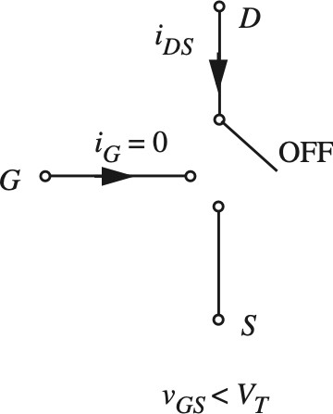
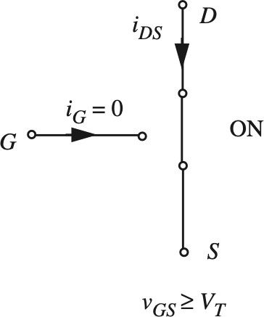
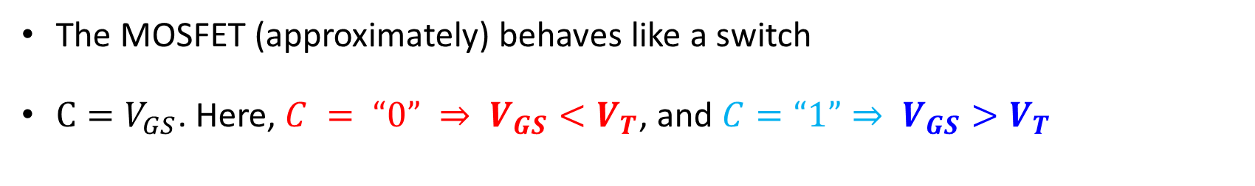
MOSFET S-Model
The MOSFET (approximately) behaves like a switch
$C=V_{GS}$. Here, $C = “0” ⇒ V_{GS}<V_{T}$, and $C=“1”⇒ V_{GS}>V_{T}$

Slide 4
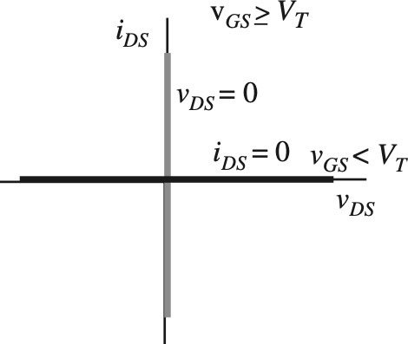
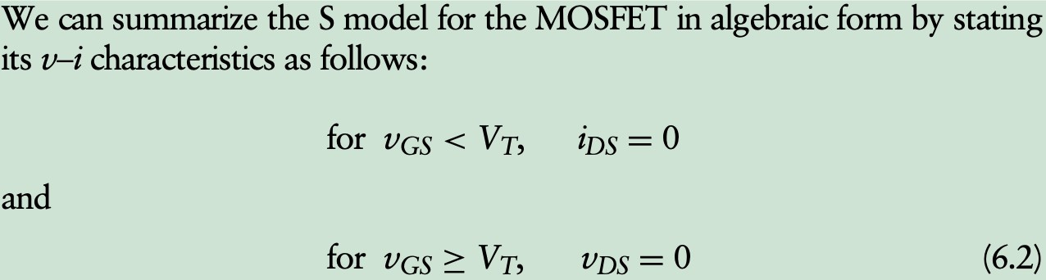
MOSFET S-Model

Slide 5
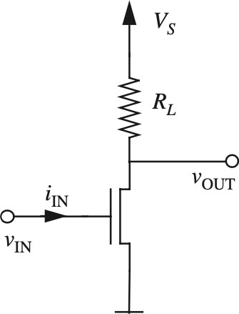
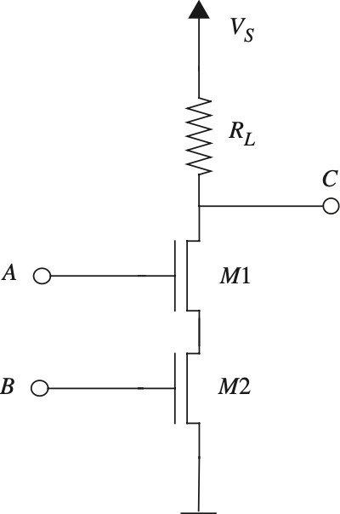
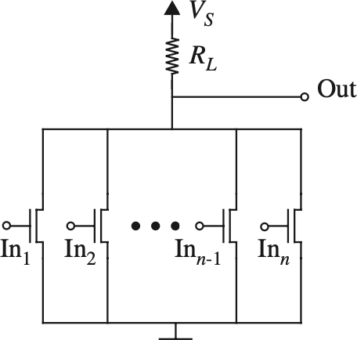
Logic Gates using MOSFET
Just replace the switches with MOSFETs!
NOT Gate (Inverter)
NAND Gate (Inverter)
NOR Gate (Inverter)

Slide 6
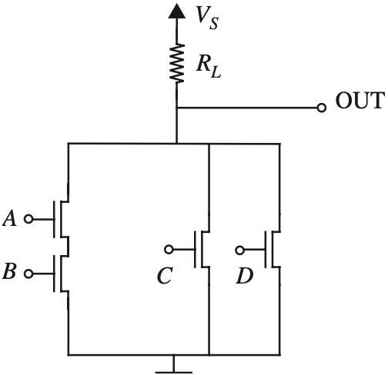
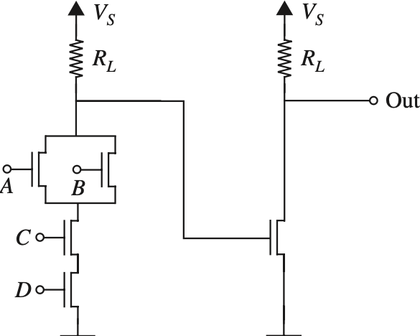
MOSFET Logic Gates – More Examples
Vs
Vs
Vs
𝑂𝑈𝑇 = 𝐴𝐵 + 𝐶 + 𝐷
𝑂𝑢𝑡 =
𝐴 + 𝐵 𝐶𝐷 =
𝐴 + 𝐵 𝐶𝐷

Slide 7
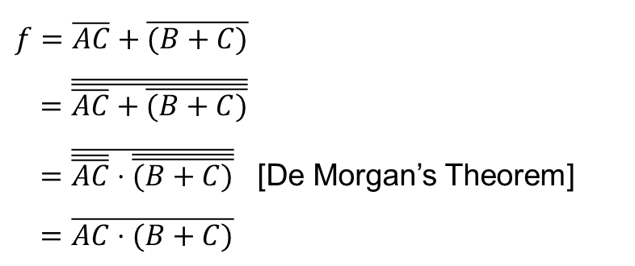



Practice Problem
Design a circuit using ideal MOSFETs (S-model) to implement the logic function
$f=\overline{AC}+\overline{(B+C)}$
$=\overline{\overline{\overline{AC}+\overline{(B+C)}}}$
$=\overline{\overline{\overline{AC}}⋅\overline{\overline{(B+C)}}}$ [De Morgan’s Theorem]
$=\overline{AC⋅(B+C)}$

Slide 8
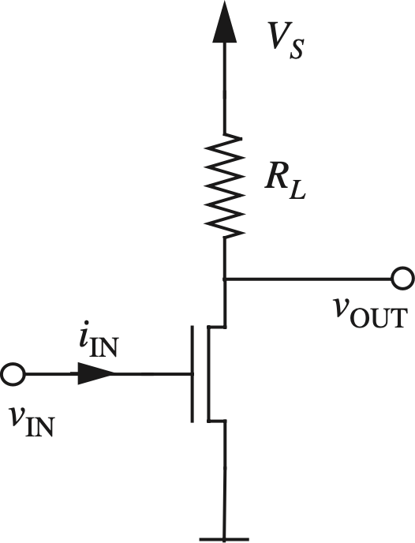
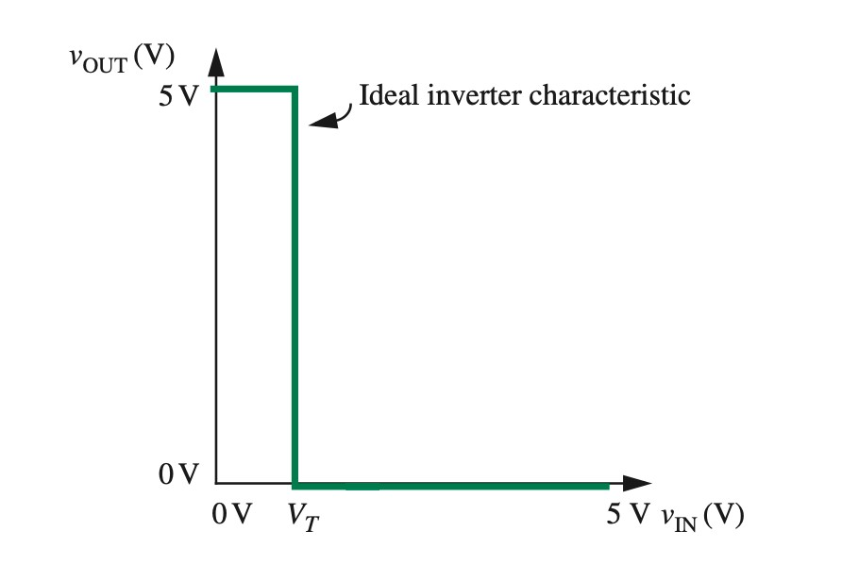
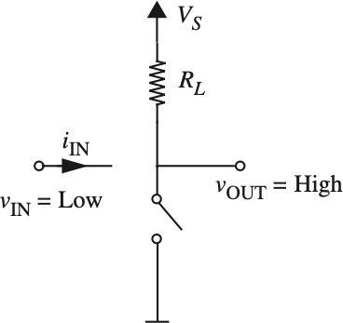
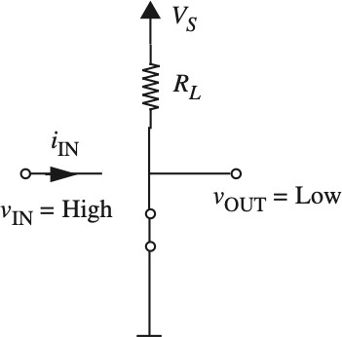

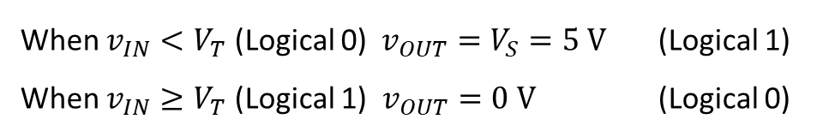
Voltage Transfer Characteristics (VTC)
Reminder: VTC is a graph where $x−$axis = input voltage, $y$-axis = output voltage
When $v_{IN}<V_{T}$ (Logical 0) $v_{OUT}=V_{S}=5 V$ (Logical 1)
When $v_{IN}≥V_{T}$ (Logical 1) $v_{OUT}=0 V$ (Logical 0)

Slide 9
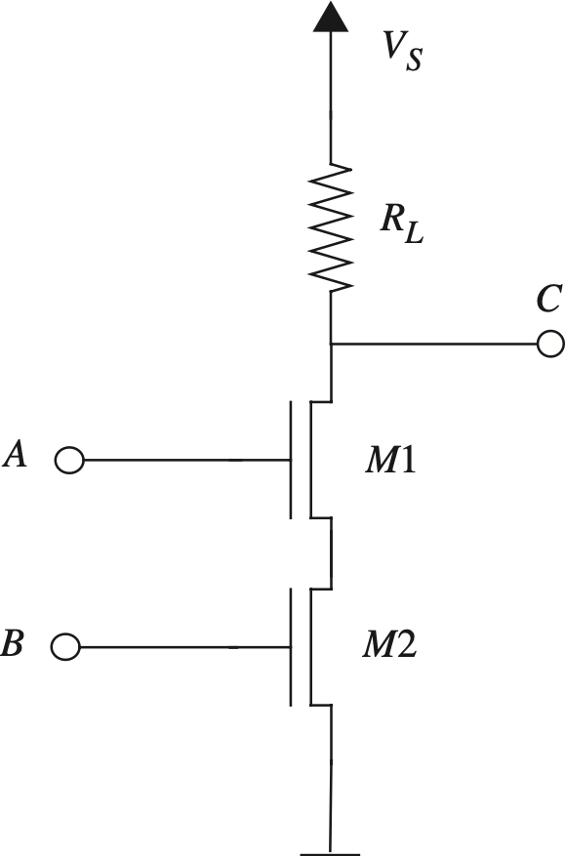
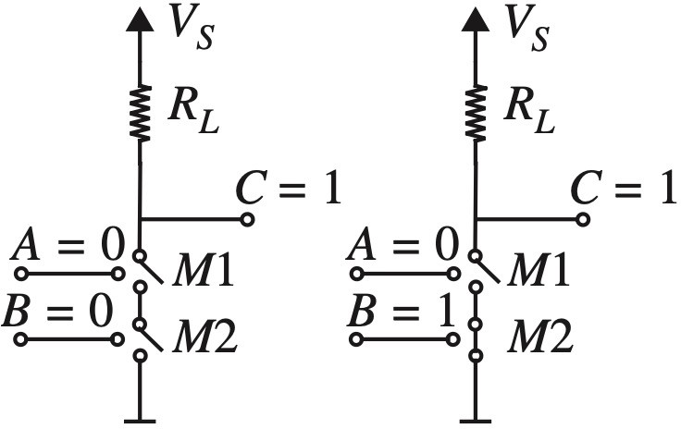
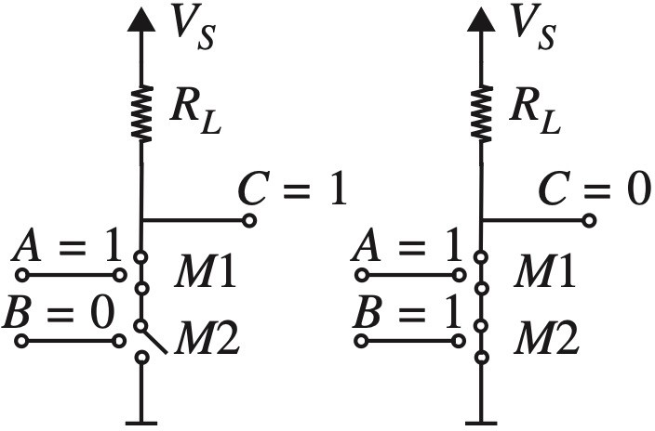

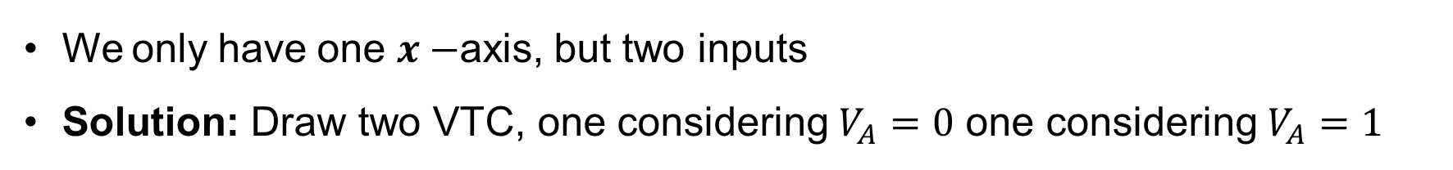

VTC of NAND gate
We only have one $x−$axis, but two inputs
Solution: Draw two VTC, one considering $V_{A}=0$ one considering $V_{A}=1$
When $V_{A}= 0$
When $V_{A}=1$

Slide 10
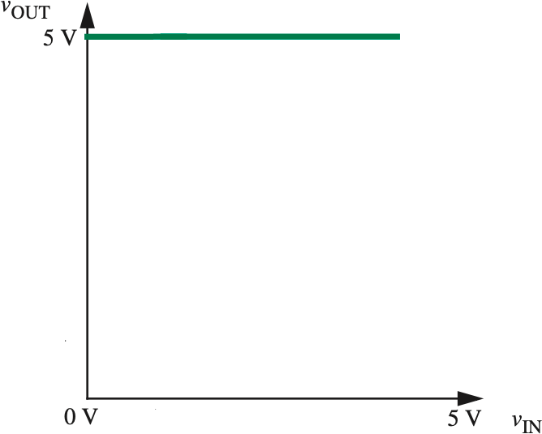
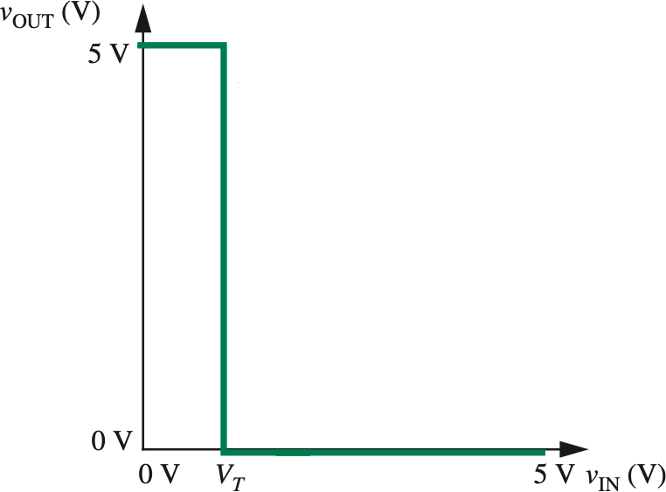
VTC of NAND gate
We only have one $x−$axis, but two inputs
Solution: Draw two VTC, one considering $V_{A}=0$ one considering $V_{A}=1$
𝑉_{Y} = 0
𝑉_{Y} = 1
When $V_{A}= 0$
When $V_{A}=1$
Homework: Find VTC for NOR gate

Slide 11
Outline
Constructing a *real* MOSFET – n/p-channel
Operation of an MOSFET-
Cut-Off
Saturation
Triode Mode
Output Characteristics
PWL Model and Non-ideal Analysis: SR model**
Real MOSFET equations
**Probably won’t cover

Slide 12
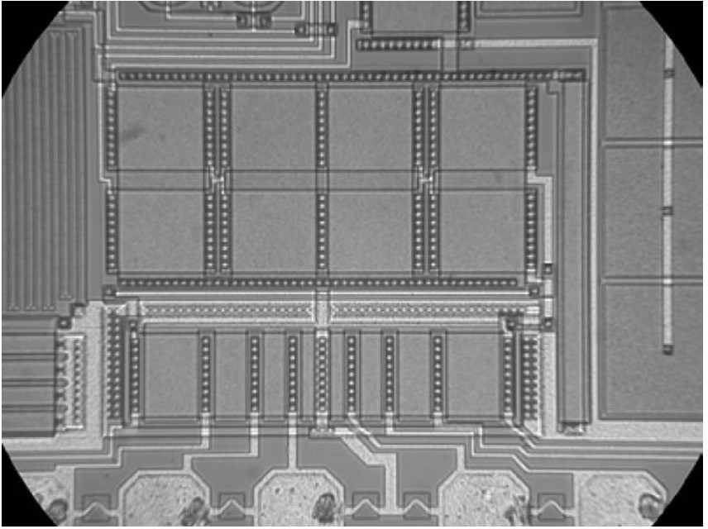
Construction of Real MOSFET
Top view of several n-channel MOSFETs fabricated on a chip. The square MOSFETs in the center of the photograph have a width and length of 100 μm. (Photograph Courtesy of Maxim Integrated Products.)
100
𝜇𝑚

Slide 13
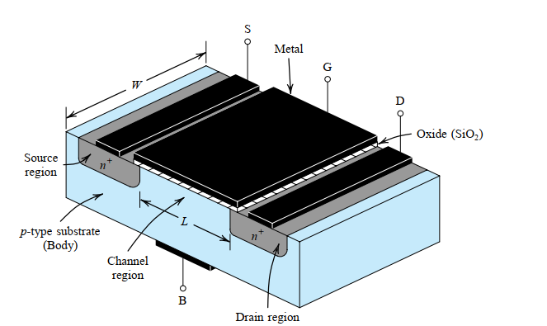
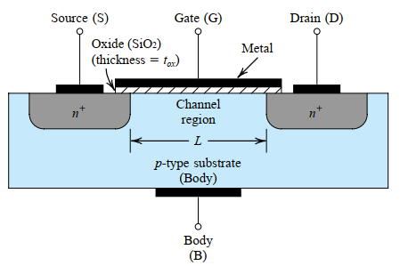
Real MOSFET – Enhancement Type
Device Structure (n-channel MOSFET)

Slide 14
n-channel MOSFET (NMOS) Physical Structure
Enhancement Type
gate
source
drain
metal
metal
oxide insulator
metal
n-type
n-type
e
e
e
h
h
e
e
e
p-type
h
h
h
h
metal

Slide 15
NMOS in Equilibrium
gate
source
drain
metal
metal
oxide insulator
metal
n-type
h
_
n-type
+
+
+
_
+
+
+
h
_
_
_
_
p-type
h
h
metal
When the transistor is left alone, some electrons from the n-type wells diffuse into the p-type material to fill holes.
This creates negative ions in the p-type material and positive ions are left behind in the n-type material.

Slide 16
NMOS in Cutoff
V_{GS} > 0
gate
+
-
source
drain
metal
metal
oxide insulator
metal
n-type
_
_
_
_
n-type
+
+
+
_
+
+
+
_
_
_
_
p-type
h
h
h
h
h
metal
When a small, positive V_{GS} is applied, holes “move away” from the gate.
Electrons from complete atoms elsewhere in the p-type material move to fill holes near the gate instead.

Slide 17
NMOS Transistor channel
V_{GS} > V_{TH(n)}
gate
+
-
source
drain
metal
metal
oxide insulator
metal
n-type
e
e
_
_
e
_
e
_
n-type
+
+
+
_
e
+
+
+
_
_
_
_
p-type
h
h
h
h
h
h
h
h
h
h
metal
When V_{GS} is larger than a threshold voltage V_{TH(n)}, the attraction to the gate is so great that free electrons collect there.
The applied V_{GS} creates an induced n-type channel under the gate (an area with free electrons).

Slide 18
NMOS Transistor Drain Current
+
-
V_{GS} > V_{TH(n)}
V_{DS} > 0
gate
+
-
source
drain
metal
metal
oxide insulator
metal
n-type
e
e
_
e
_
e
_
e
_
n-type
+
+
+
_
+
+
+
_
_
_
_
p-type
h
h
h
h
h
h
h
h
h
h
metal
When a positive V_{DS} is applied, the free electrons flow from the source to the drain. (Positive current flows from drain to source).
The amount of current depends on V_{DS}, as well as the number of electrons in the channel, channel dimensions, and material.

Slide 19
NMOS Transistor Circuit symbol
V_{DS}
+
-
V_{GS}
drain
gate
I_{D}
+
-
I_{G}
source
metal
metal
oxide insulator
metal
n-type
n-type
p-type
metal
G
+
V_{GS}
_
I_{G}
I_{D}
S
- V_{DS} +
D

Slide 20
NMOS I-V Characteristic
G
+
V_{GS}
_
I_{G}
I_{D}
S
- V_{DS} +
D
Since the transistor is a 3-terminal device, there is no single I-V characteristic.
Note that because of the insulator, I_{G} = 0 A.
We typically define the MOS I-V characteristic as
I_{D} vs. V_{DS} for a fixed V_{GS}.
The I-V characteristic changes as V_{GS} changes.

Slide 21
Modes of Operation
For small values of V_{GS}, V_{GS} ≤ V_{TH(n)}, the n-type channel is not formed. No current flows. This is cutoff mode.
When V_{GS} > V_{TH(n)}, current I_{D} may flow from drain to source, and the following modes of current flow are possible.
The mode of current flow depends on the propelling voltage, V_{DS}, and the channel-inducing voltage,
V_{GS} – V_{TH(n)}.
When V_{DS} < V_{GS} – V_{TH(n)}, current is starting to flow. I_{D} increases rapidly with increased V_{DS}. This is triode mode.
When V_{DS} ≥ V_{GS} – V_{TH(n)}, current is reaching its maximum value. I_{D} does not increase much with increased V_{DS}. This is called saturation mode.

Slide 22
Water Tap Analogy
Imagine the water tap on your kitchen sink.
To make water flow, the water supply has to be connected to the water tap. This establishes a path for water to flow.
Setting V_{GS} above the threshold voltage is like connecting the water supply.
Cutoff = water supply disconnected (no path for current flow)
Setting V_{GS} to a larger value is like connecting a high-pressure water supply—more flow can potentially occur.

Slide 23
Water Tap Analogy
 | MOSFET Schematic |  | Water Tap

Slide 24
Water Tap Analogy
The water tap itself is used to adjust water flow. You can turn the flow up and down.
V_{DS} is like the water tap. It controls the amount of flow.
There is, of course, a saturation point. If you keep turning the water tap control, eventually you won’t get any more flow.
Triode = water tap in “normal range”, controls flow
Saturation = water tap turned up to (or past) point for maximum flow

Slide 25
Water Tap Analogy

Slide 26
Water Tap Analogy

Slide 27
Water Tap Analogy

Slide 28





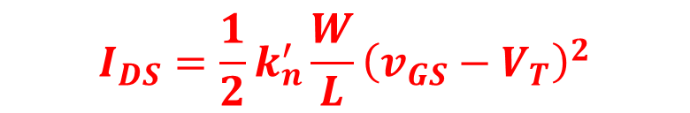
NMOS Equations
Cutoff Mode
Occurs when $v_{GS}<V_{T}$
$ID = 0$
Triode Mode
Occurs when $v_{GS}≥V_{T}$and $v_{DS} < vGS − V_{T}$
Saturation Mode
Occurs when $vGS > VT$ and $vDS ≥ vGS − VT$
$v_{GS}−V_{T}=V_{OV}$: Overdrive Voltage
$$V_{OV}$$
Indicates the available excess voltage at gate after forming the n-channel.
$$I_{DS}=k_{n}^{′}\frac{W}{L}\left(v_{GS}−V_{T}−\frac{1}{2}v_{DS}\right)v_{DS}$$
$$V_{T}$$
The minimum voltage necessary at the gate terminal to form a channel.
$$I_{DS}=\frac{1}{2}k_{n}^{′}\frac{W}{L}{\left(v_{GS}−V_{T}\right)}^{2}$$

Slide 29
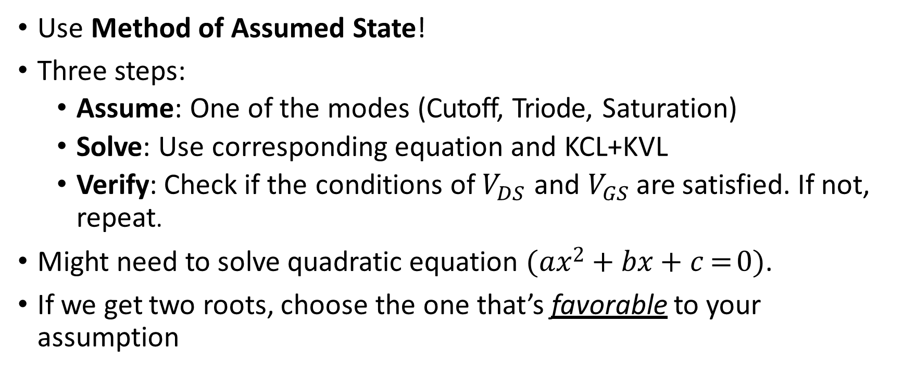
Solving Circuits with MOSFET
Use Method of Assumed State!
Three steps:
Assume: One of the modes (Cutoff, Triode, Saturation)
Solve: Use corresponding equation and KCL+KVL
Verify: Check if the conditions of $V_{DS}$ and $V_{GS}$ are satisfied. If not, repeat.
Might need to solve quadratic equation (𝑎𝑥² + 𝑏𝑥 + 𝑐 = 0).
If we get two roots, choose the one that’s favorable to your assumption

Slide 30
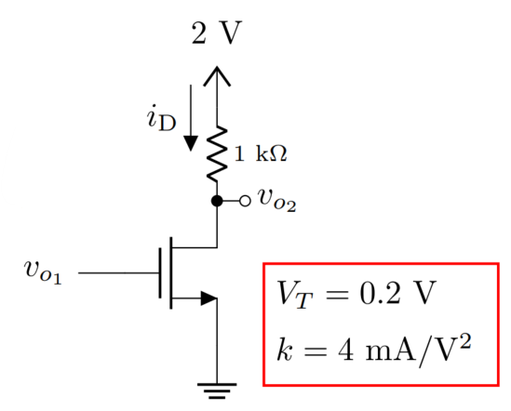
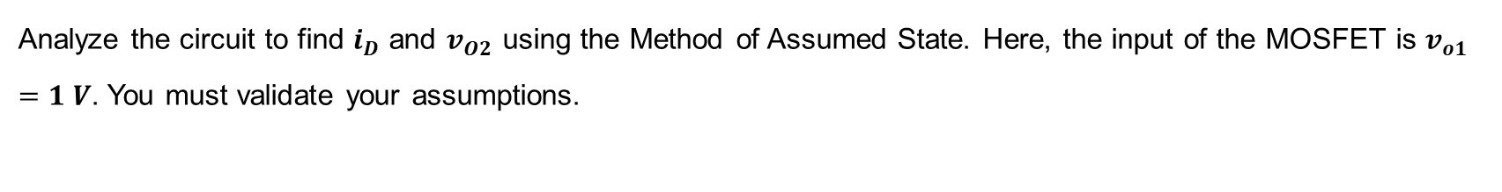
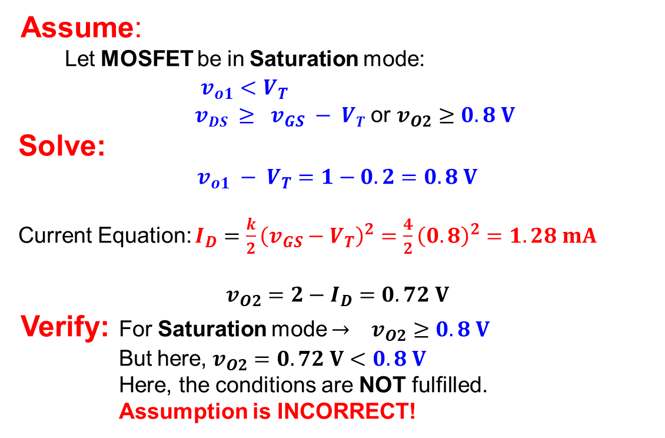
Example 1
Analyze the circuit to find $i_{D}$ and $v_{O2}$ using the Method of Assumed State. Here, the input of the MOSFET is $v_{o1}=1 V$. You must validate your assumptions.
Assume:
Let MOSFET be in Saturation mode:
$v_{o1}<V_{T}$
$vDS ≥ v_{GS} − VT$ or $v_{O2}≥0.8 V$
Solve:
$$v_{o1} − V_{T}=1−0.2=0.8 V$$
Current Equation: $I_{D}=\frac{k}{2}{\left(v_{GS}−V_{T}\right)}^{2}=\frac{4}{2}{\left(0.8\right)}^{2}=1.28 mA$
$$v_{O2}=2−I_{D}=0.72 V$$
Verify: For Saturation mode $→$ $v_{O2}≥0.8 V$
But here, $v_{O2}=0.72 V<0.8 V$
Here, the conditions are NOT fulfilled.
Assumption is INCORRECT!

Slide 31
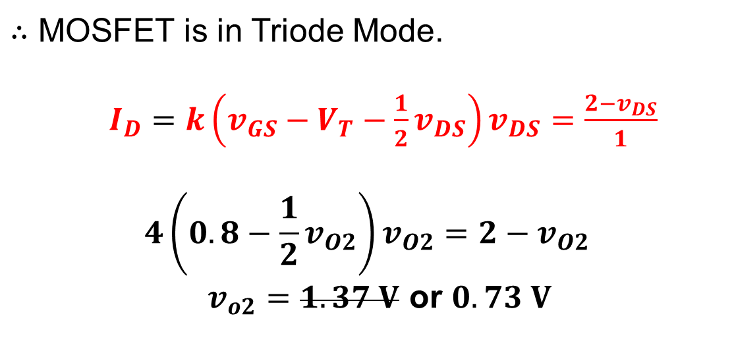
Example 1
Analyze the circuit to find $i_{D}$ and $v_{O2}$ using the Method of Assumed State. Here, the input of the MOSFET is $v_{o1}=1 V$. You must validate your assumptions.
$∴$ MOSFET is in Triode Mode.
$I_{D}=k\left(v_{GS}−V_{T}−\frac{1}{2}v_{DS}\right)v_{DS}=\frac{2−v_{DS}}{1}$
$$4\left(0.8−\frac{1}{2}v_{O2}\right)v_{O2}=2−v_{O2}$$
$v_{o2}=1.37 V$ or $0.73 V$

Slide 32
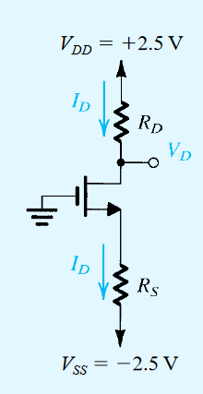


Example 2
Design the circuit, that is, determine the values of $R_{D}$ and $R$, so that the transistor operates at $I_{D} = 0.4 mA$and $V_{D} =+0.5 V$. The NMOS transistor has $V_{T}=0.7 V$, $k=3.2 mA/V^{2}$.
$$R_{D}=\frac{V_{DD}−V_{D}}{I_{D}}=\frac{2.5−0.5}{0.4}=5 kΩ$$
Assume:
Let MOSFET be in Saturation mode:
$v_{GS}>V_{T}$
$vDS ≥ v_{GS} − V_{T}$
Solve:
$$v_{GS}=−V_{S}$$
$$V_{GS}−V_{T}=−V_{S}−0.7$$
Current Equation: $I_{D}=\frac{k}{2}{\left(v_{GS}−V_{T}\right)}^{2}=\frac{3.2}{2}{\left(−V_{S}−0.7\right)}^{2}=0.4 mA$
$V_{S}=−0.2 V$ or $−1.2 V$

Slide 33


Example 2
Design the circuit, that is, determine the values of $R_{D}$ and $R$, so that the transistor operates at $I_{D} = 0.4 mA$and $V_{D} =+0.5 V$. The NMOS transistor has $V_{T}=0.7 V$, $k=3.2 mA/V^{2}$.
Verify:
$$V_{DS}=0.5−V_{S}=1.7 V$$
$$V_{GS}−V_{T}=−V_{S}−0.7=0.5 V$$
Clearly $V_{DS}≥V_{GS}−V_{T}$
Assumption is CORRECT!
$$R_{S}=\frac{V_{S}−V_{SS}}{I_{D}}=\frac{−1.2−(−2.5)}{0.4}=5.75 kΩ$$

Slide 34
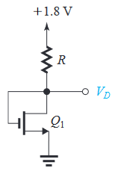
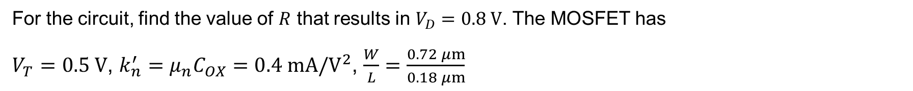
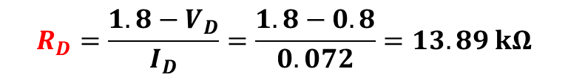
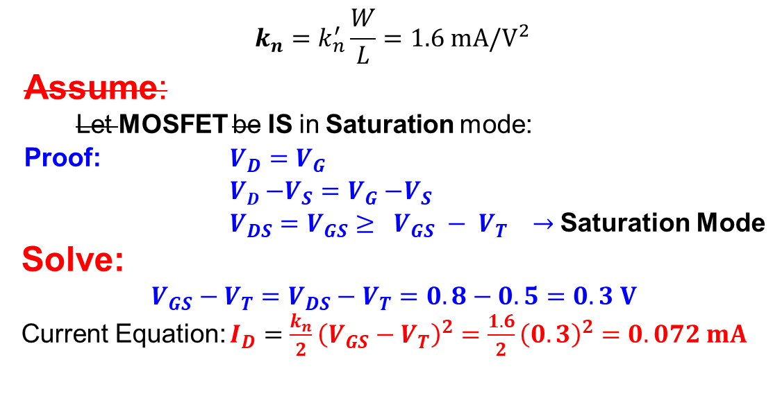
Example - 3
For the circuit, find the value of $R$ that results in $V_{D}=0.8 V$. The MOSFET has $V_{T}=0.5 V$, $k_{n}^{′}=μ_{n}C_{OX}=0.4 mA/V^{2}$, $\frac{W}{L}=\frac{0.72 μm}{0.18 μm}$
$$k_{n}=k_{n}^{′}\frac{W}{L}=1.6 mA/V^{2}$$
Assume:
Let MOSFET be IS in Saturation mode:
Proof: $V_{D}=V_{G}$
$VD{−V_{S}=V}_{G}−V_{S}$
$V_{DS}=V_{GS}≥ V_{GS} − V_{T} →$Saturation Mode
Solve:
$$V_{GS}−V_{T}=V_{DS}−V_{T}=0.8−0.5=0.3 V$$
Current Equation: $I_{D}=\frac{k_{n}}{2}{\left(V_{GS}−V_{T}\right)}^{2}=\frac{1.6}{2}{\left(0.3\right)}^{2}=0.072 mA$
$$R_{D}=\frac{1.8−V_{D}}{I_{D}}=\frac{1.8−0.8}{0.072}=13.89 kΩ$$

Slide 35
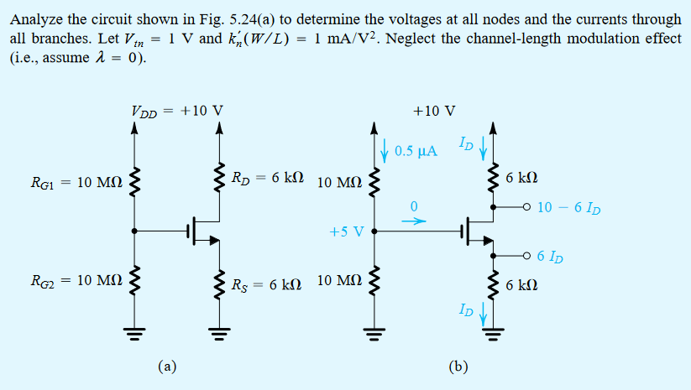
Example - 4

Slide 36
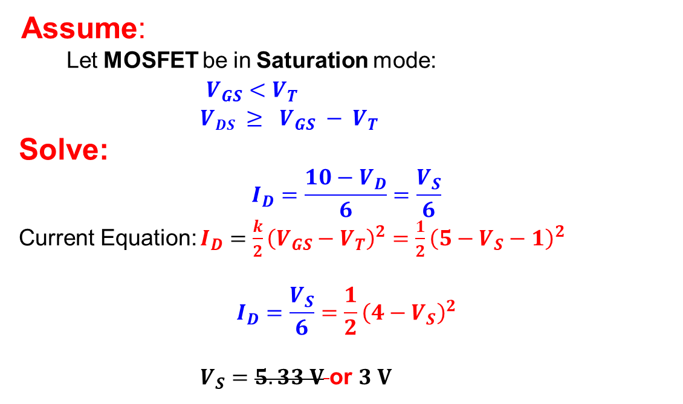
Example - 4
Assume:
Let MOSFET be in Saturation mode:
$V_{GS}<V_{T}$
$VDS ≥ V_{GS} − V_{T}$
Solve:
$$I_{D}=\frac{10−V_{D}}{6}=\frac{V_{S}}{6}$$
Current Equation: $I_{D}=\frac{k}{2}{\left(V_{GS}−V_{T}\right)}^{2}=\frac{1}{2}{\left(5−V_{S}−1\right)}^{2}$
$$I_{D}=\frac{V_{S}}{6}=\frac{1}{2}{\left(4−V_{S}\right)}^{2}$$
$V_{S}=5.33 V$ or $3 V$

Slide 37
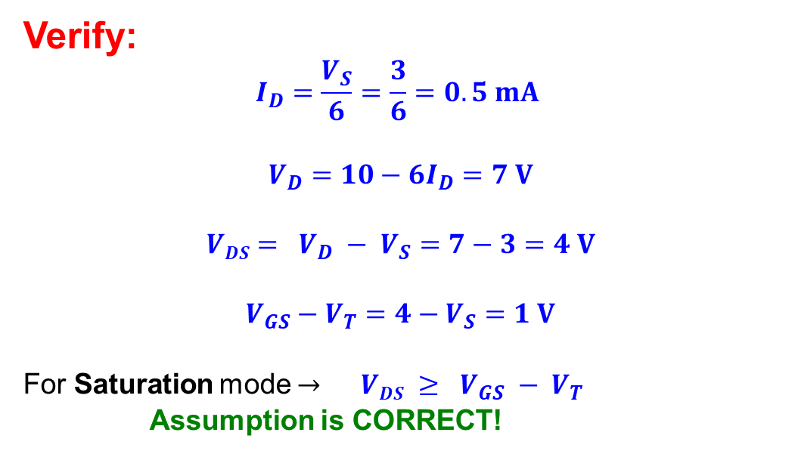
Example - 4
Verify:
$$I_{D}=\frac{V_{S}}{6}=\frac{3}{6}=0.5 mA$$
$$V_{D}=10−6I_{D}=7 V$$
$$VDS= V_{D} − V_{S}=7−3=4 V$$
$$V_{GS}−V_{T}=4−V_{S}=1 V$$
For Saturation mode $→$ $VDS ≥ V_{GS} − V_{T}$
Assumption is CORRECT!

Slide 38



Example - 5
Solve:
Both MOSFET are in SATURATION:
Q1: $V_{GS1}−V_{T}=1−V_{T}=1−0.5=0.5 V$
Q2: $V_{GS2}−V_{T}=\left(1.8−1\right)−V_{T}=0.8−0.5=0.3 V$
Current Equation:
$$I_{D}=\frac{μ_{n}C_{ox}}{2}\left(\frac{W_{1}}{L_{1}}\right){\left(V_{GS1}−V_{T}\right)}^{2}=\frac{μ_{n}C_{ox}}{2}\left(\frac{W_{2}}{L_{2}}\right){\left(V_{GS2}−V_{T}\right)}^{2}=0.25 mA$$
$$\frac{0.25}{2}\left(\frac{W_{1}}{0.25}\right){\left(0.5\right)}^{2}=\frac{0.25}{2}\left(\frac{W_{2}}{0.25}\right){\left(0.3\right)}^{2}=0.25$$

Slide 39


Example - 5
$$R=\frac{2.5−1.8}{I_{D}}=2.8 kΩ$$
Solve:
$$I_{D}=\frac{μ_{n}C_{ox}}{2}\left(\frac{W_{1}}{L_{1}}\right){\left(V_{GS1}−V_{T}\right)}^{2}=\frac{μ_{n}C_{ox}}{2}\left(\frac{W_{2}}{L_{2}}\right){\left(V_{GS2}−V_{T}\right)}^{2}=0.25 mA$$
$$\frac{0.25}{2}\left(\frac{W_{1}}{0.25}\right){\left(0.5\right)}^{2}=\frac{0.25}{2}\left(\frac{W_{2}}{0.25}\right){\left(0.3\right)}^{2}=0.25$$
$$W_{1}×0.25=W_{2}×0.09=2×0.25$$
$$\frac{W_{1}}{4}=\frac{{9W}_{2}}{100}=\frac{1}{2}$$
$W_{1}=2 μm$ or $W_{2}=5.556 μm$

Slide 40




NMOS I-V Characteristic
$I_{DS}$ vs $V_{DS}$
$$I_{DS}$$
When $v_{GS}<v_{T}$:
$I_{DS}=0$ for any $V_{DS}$
$$V_{DS}$$

Slide 41
NMOS I-V Characteristic
I_{D}
triode mode
saturation mode
V_{GS} = 3 V
V_{DS} = V_{GS} - V_{T}
V_{GS} = 2 V
V_{GS} = 1 V
cutoff mode (when V_{GS} < V_{TH(N)})
V_{DS}

Slide 42






n-channel MOSFET - Summary
No channel, open ckt
The created channel will have some R
-> SR model
G – Gate: Trigger terminal
S – Source: Charge carrier reservoir
D – Drain: Charge carrier sink
$$V_{GS}>V_{T}$$
$$V_{GS}=0 V$$
Cut off mode
Small $v_{DS}:$ Triode Mode
Large $v_{DS}:$ Saturation Mode

Slide 43




n-channel MOSFET - Summary
SR Model:
$$R_{ON}=\frac{1}{k_{n}(V_{OV})}$$
$$V_{OV}$$
Indicates the available excess voltage at gate after forming the n-channel.
SR model is a better approximation than S model.
Triode Mode exists until: $v_{DS}$ <=$(v_{GS}−V_{T})$

Slide 44







Review – MOSFET
Control ${=V}_{GS}=V_{G}−V_{S}$ controls the IV between drain-source ($I_{DS}$ vs $V_{DS}$)
Threshold voltage = 𝑉_{T}, minimum voltage required to create the channel
Models
S Mode: Assumes an ideal channel with zero resistance
SR Model: Assumes finite channel resistance, $R_{ON},$depends on $V_{GS}−V_{T}=V_{OV}$

Slide 45




IV Characteristics of Real MOSFET
Mode | Condition | Equation
Cutoff | 𝑉%& < 𝑉' | 𝐼₎ = 0
Triode | 𝑉%& ≥ 𝑉' ^{𝑉})& ^{< 𝑉}!( | 𝐼 = 𝑘[𝑉 𝑉 − ¹ 𝑉* ] ) !( )& ₂ )&
Saturation | 𝑉%& ≥ 𝑉' ^{𝑉})& ^{≥ 𝑉}!( | 𝐼 = ^{𝑘} 𝑉* ) ₂ !(
$$V_{GS}−V_{T}=V_{OV}$$
$$k_{n}=\frac{k_{n}^{′}W}{L}$$

